Slide 1
SVM Kernels

Slide 2
Outline
Recap
What is the Kernel trick?
Types of Kernels

Slide 3
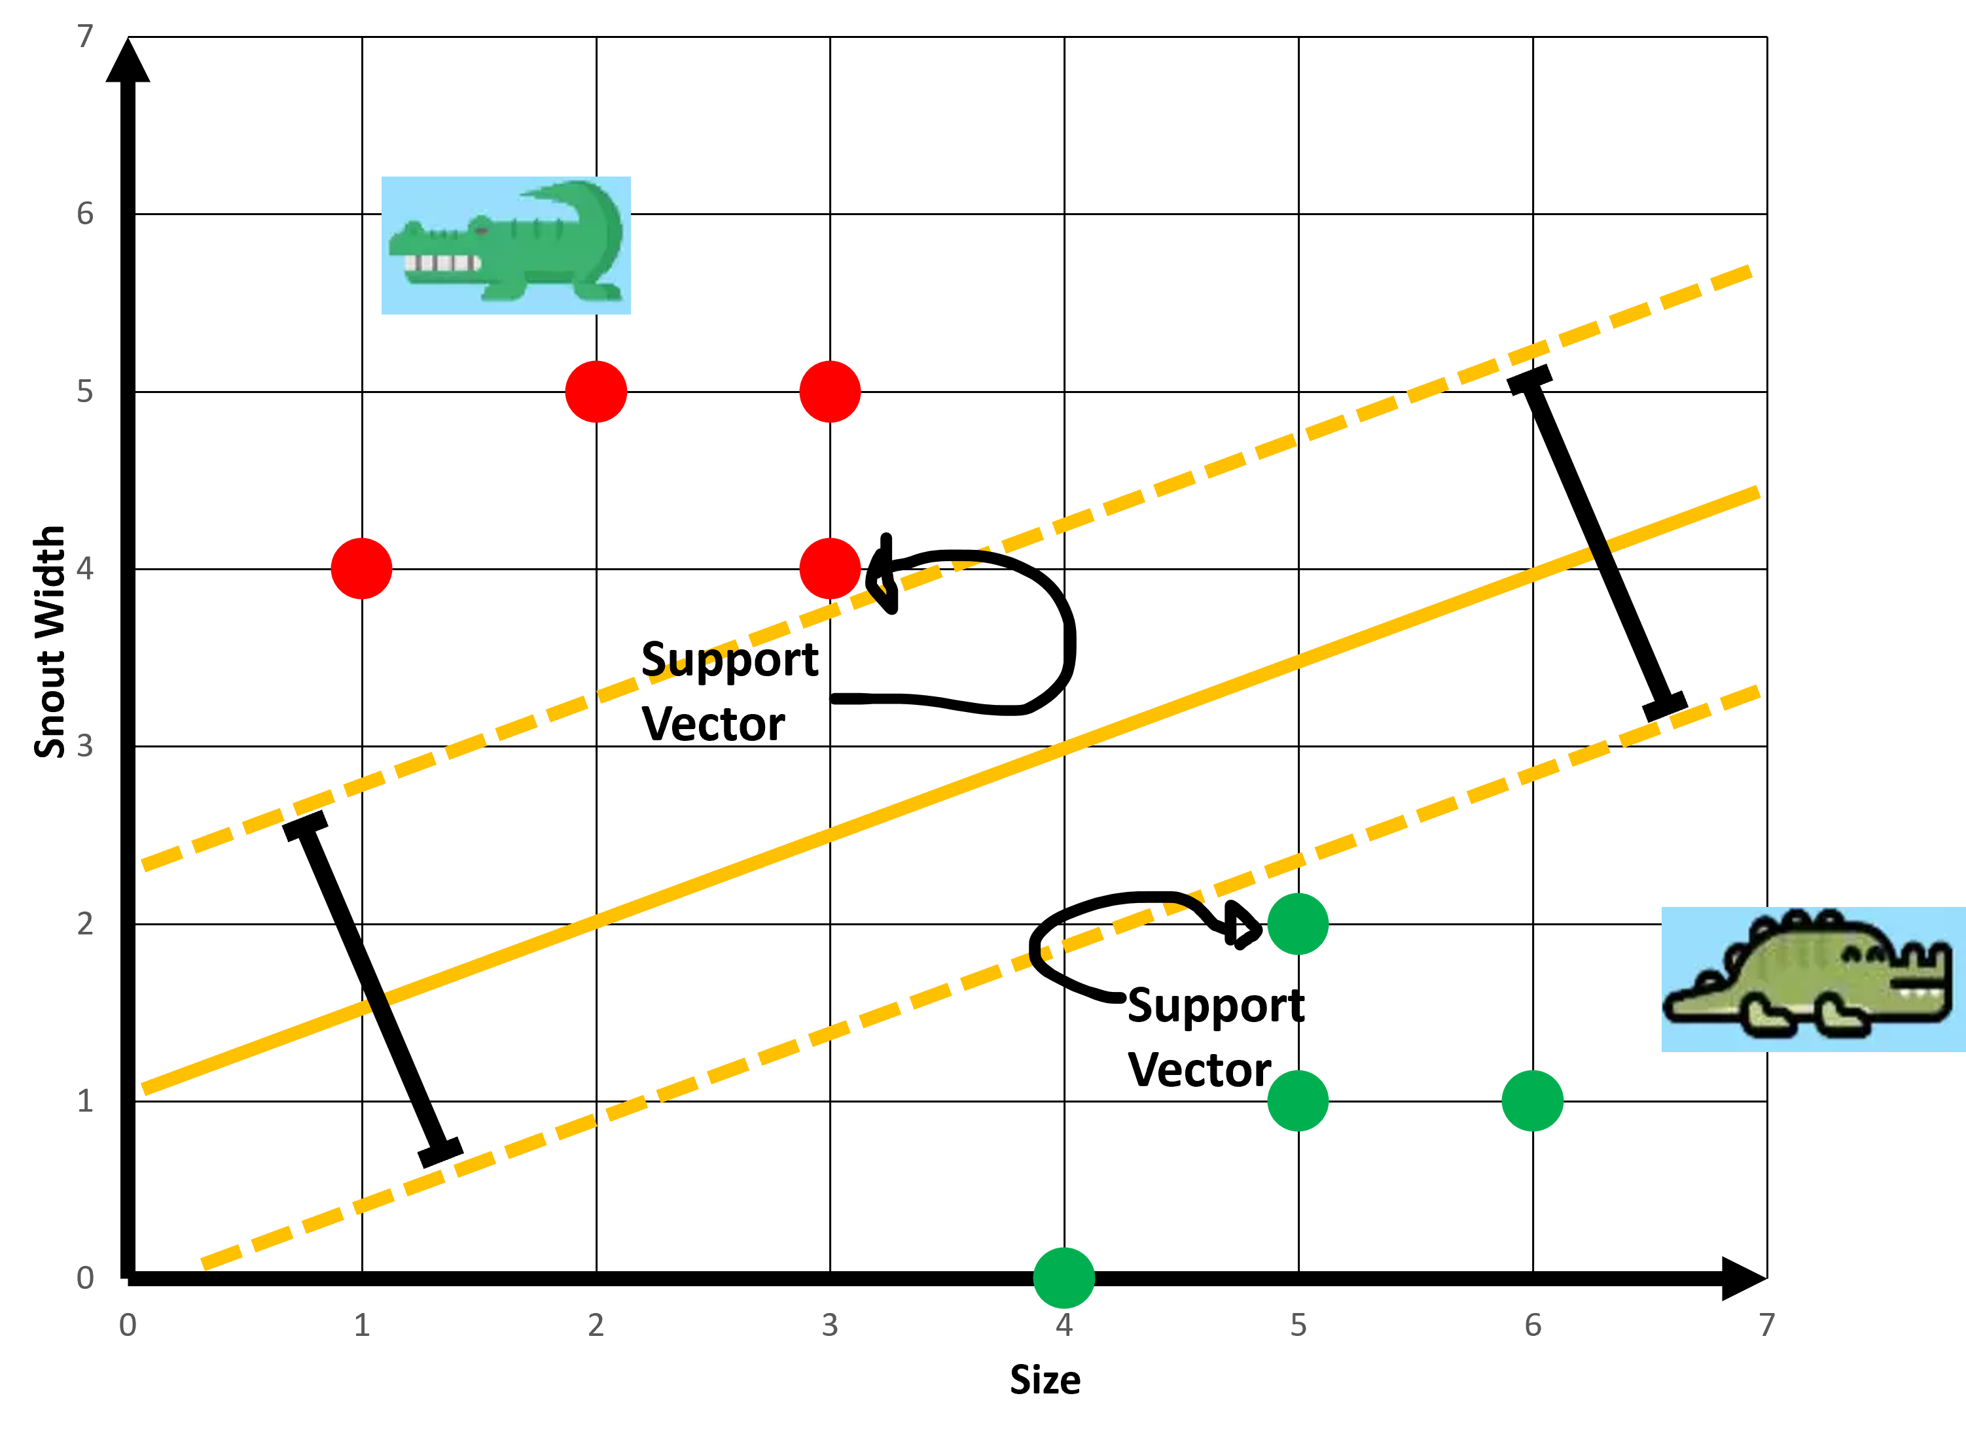
Recap: SVM

Slide 4
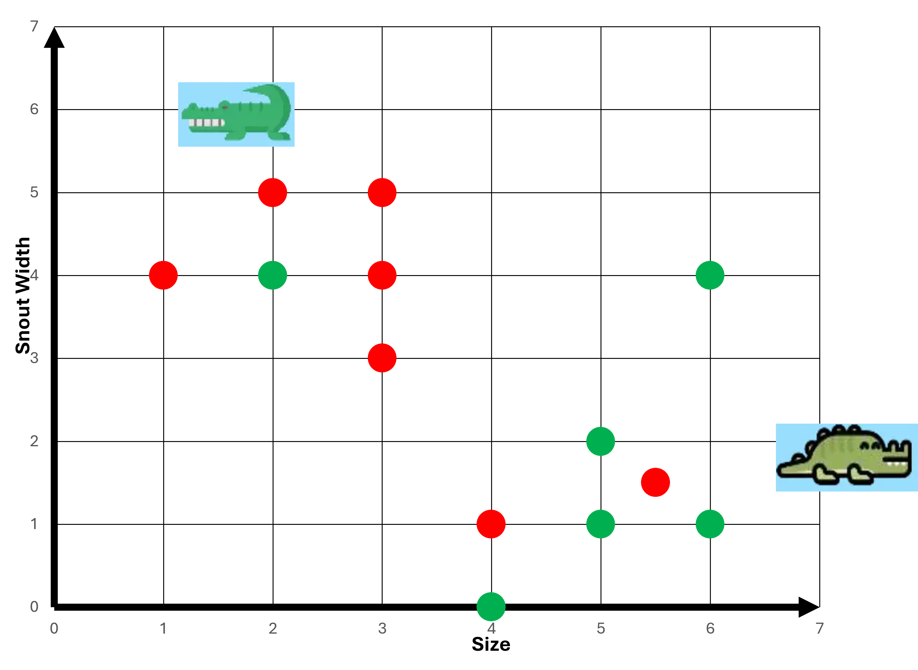
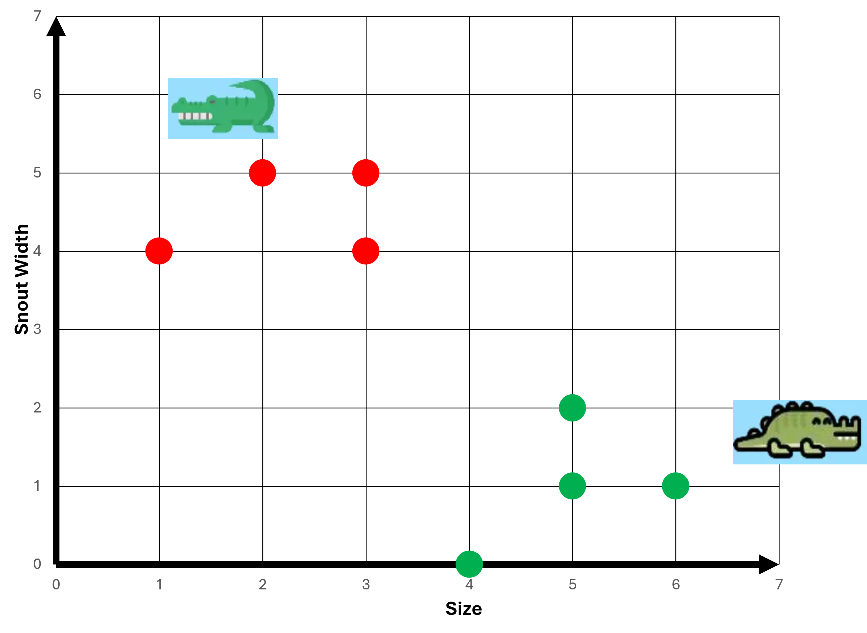
Recap: SVM
Linearly separable
Not linearly separable

Slide 5
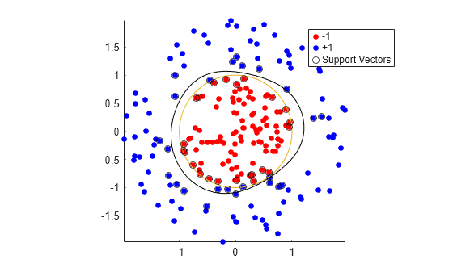
Other forms of data are not linearly separable

Slide 6
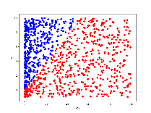
Other forms of data are not linearly separable

Slide 7
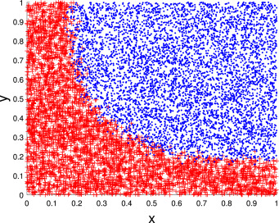
Other forms of data are not linearly separable

Slide 8
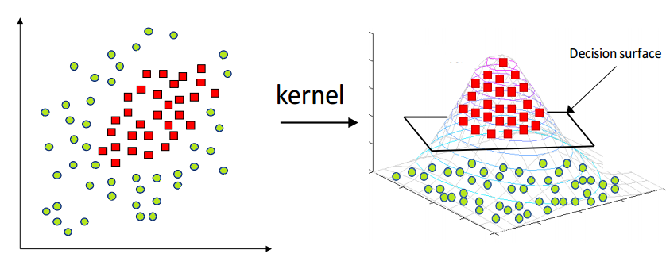
What is Kernel Trick in SVM?
Transforming a data from another dimension without actually doing it

Slide 9
Kernel

Slide 10
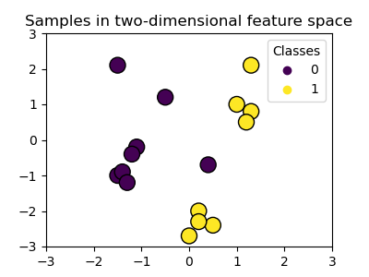

Slide 11
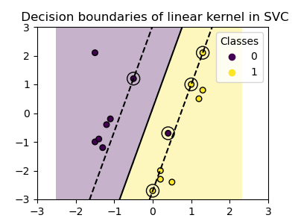
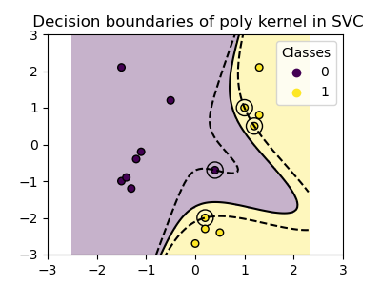
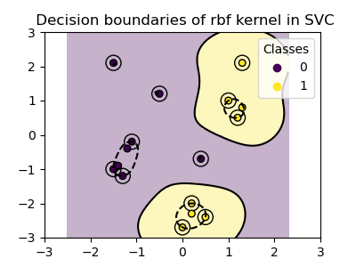
Types of Kernels
Linear
Polynomial
RBF

Slide 12
Linear Kernel
Linear

Slide 13
Linear Kernel
Linear kernel is the dot product of the input samples
Works if data is already linearly separable.

Slide 14
Polynomial Kernel
The polynomial kernel changes the notion of similarity.
Can make curved boundaries.

Slide 15
Polynomial Kernel
Linear

Slide 16
Radial basis function (RBF) Kernel
The radial basis function (RBF) kernel, also known as the Gaussian kernel, is the default kernel for Support Vector Machines in scikit-learn.
Can handle blobs, spirals, donuts.

Slide 17
Radial basis function (RBF) Kernel

Slide 19
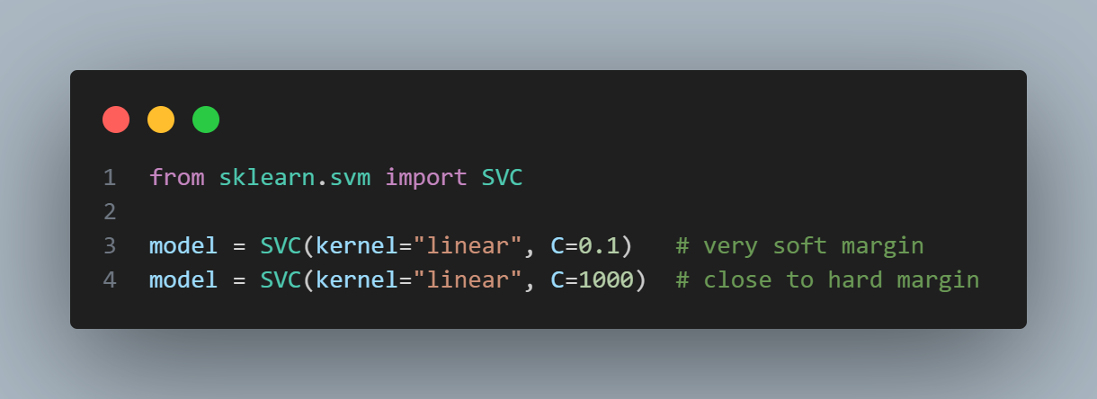
C parameter

Slide 20
Purpose of Kernels in SVM
Make data separable by implicitly mapping it to higher dimensions.
Avoid expensive calculations — compute results as if we transformed the data.
Flexibility different ways of bending/twisting the space.

